Slide 1
Python
Graphic
with Turtle II
in programming

Slide 2
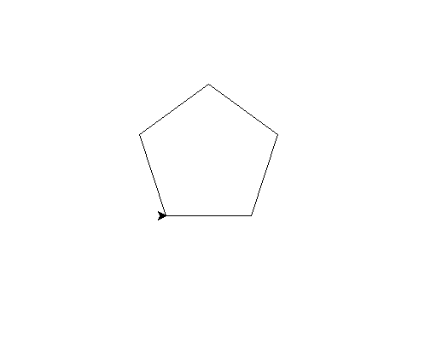
Code and learn with examples
from turtle import *
s = getscreen()
t = Turtle()
t.fd(100)
t.lt(72)
t.fd(100)
t.lt(72)
t.fd(100)
t.lt(72)
t.fd(100)
t.lt(72)
t.fd(100)
t.lt(72)
mainloop()
pentagon
Distance to move
Angle to rotate
Keep showing window

Slide 3
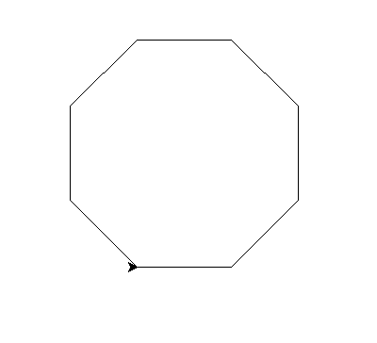
Code and learn with examples
from turtle import *
s = getscreen()
t = Turtle()
for i in range(8):
t.fd(100)
t.lt(45)
mainloop()
Octagon but with a loop
Do it 8 times
Create 100px line
Rotate 45 deg

Slide 4
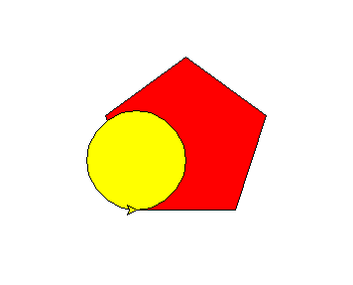
Code and learn with examples
from turtle import *
fillcolor('red') begin_fill()
for i in range(5):
fd(100)
lt(72)
end_fill() fillcolor('yellow')
begin_fill()
circle(50)
end_fill() mainloop()
Colored shapes
Set filling color to red
set before the shape creation code
Create a shape
Tell turtle to fill the color in shape
Same concept for circle color

Slide 5
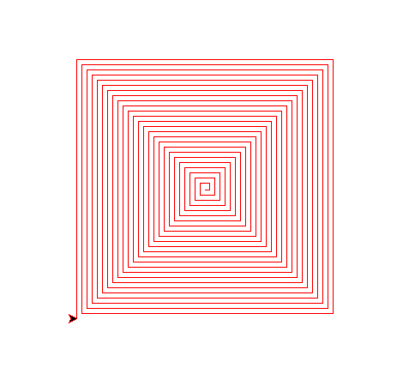
Code and learn with examples
from turtle import *
speed('slow')
pencolor('red')
for i in range(100):
fd(i*3+5) # 11
lt(90)
mainloop()
Concentric Squares
Set turtle speed to slower pace
Change line color to red
Do following 100 times
Take i, multiply by 3 and add 5, move that distance
Rotate 90 deg

Slide 6
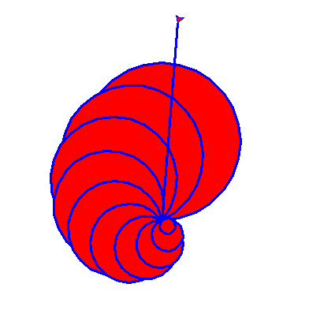
Code and learn with examples
from turtle import *
pencolor('blue')
pensize(3)
fillcolor('red')
speed('fastest')
for i in range(10,0,-1):
begin_fill()
circle(i*10)
lt(25)
end_fill()
goto(20,250)
mainloop()
Shell pattern with circles
Change line color to blue
Change pen width to 3
Set turtle speed to fastest
Run loop in reverse from 10 to 1
Make circles with value of i * 10, where i changes every turn from 10 to 1
Rotate 25 deg
Jump to new x , y position

Slide 7
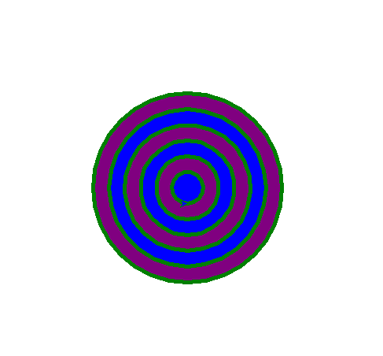
Code and learn with examples
from turtle import * s = Screen()
s.setup(1000,700) colors = ['purple','blue']
pencolor('green')
pensize(5) for i in range(6,0,-1):
penup()
setpos(0,20*i)
pendown()
fillcolor(colors[i%2])
begin_fill()
circle(20*i)
end_fill() mainloop()
Concentric circles
Change screen size using x and y pixels
List of colors
Change pen size
Move pen up from screen
Move to a position on y axis
Put pen down
Create circle with diff. radius because i changes every turn of loop

Slide 8
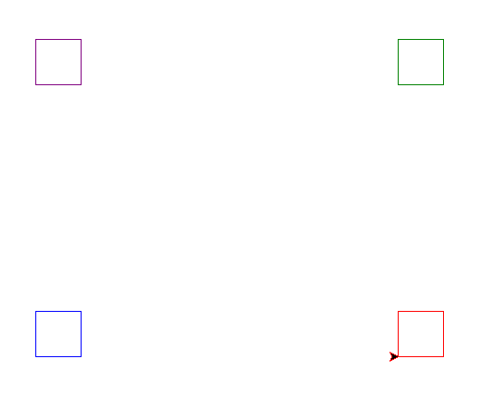
Code and learn with examples
from turtle import *
colors = ['purple','green’,
'blue','red’]
pencolor(colors[0])
penup()
goto(-200,150)
pendown()
for i in range(4):
fd(50)
lt(90)
pencolor(colors[1])
penup()
goto(200,150)
pendown()
for i in range(4):
fd(50)
lt(90)
Shape placement on screen
pencolor(colors[2])
penup()
goto(-200,-150)
pendown()
for i in range(4):
fd(50)
lt(90)
pencolor(colors[3])
penup()
goto(200,-150)
pendown()
for i in range(4):
fd(50)
lt(90)
mainloop()
BOX 3
BOX 1
BOX 4
BOX 2

Slide 9
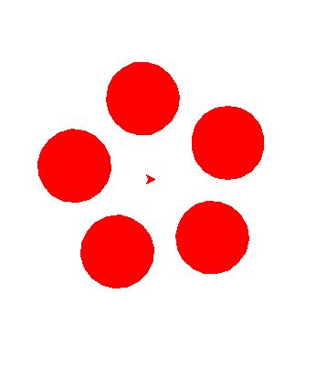
Code and learn with examples
from turtle import * s = Screen()
s.setup(500,500)
fillcolor('red')
pencolor('red')
for i in range(5):
lt(72)
penup()
fd(80)
pendown()
begin_fill()
circle(40)
end_fill()
penup()
bk(80)
pendown()
mainloop()
A flower with petals
Change screen size using x and y pixels
Rotate 72 deg
Move pen up from screen
Move turtle forward to 80
Put pen down
Set coloring
Create a circle of radius 40
Fill color in created circle
Keep the pen up again
Move turtle back 80 to mid
Put the pendown

Slide 10
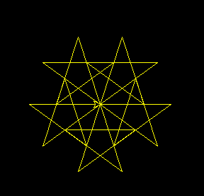
Code and learn with examples
from turtle import *
s = Screen()
s.setup(400,400)
s.bgcolor('black')
pencolor('yellow')
for i in range(5):
lt(72)
for i in range(5):
fd(100)
rt(144)
mainloop()
Star pattern
Set background to black

Slide 11
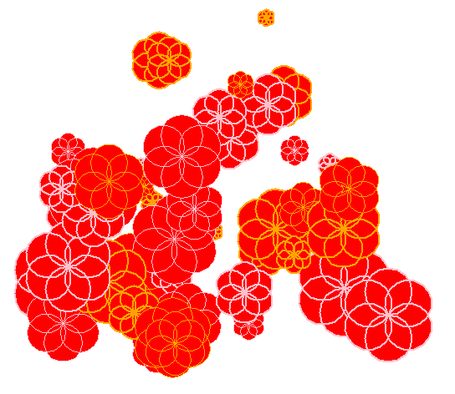
Code and learn with examples
from turtle import *
import random
s =Screen()
s.setup(500,500)
colors = ['pink','orange']
for i in range(50):
x = random.randint(-200,200)
y = random.randint(-200,200)
penup()
goto(x,y)
pendown()
# write(f'{x},{y}')
pensize(random.randint(1,2))
pencolor(colors[random.randint(0,1)])
radius = random.randint(5,30)
fillcolor('red')
begin_fill()
for i in range(6):
circle(radius)
left(60)
end_fill()
mainloop()
Import random library
Random flower pattern
Get random value for x
Get random value for y
Select a random pensize
Select a random color
Create a six sided flower

Slide 12
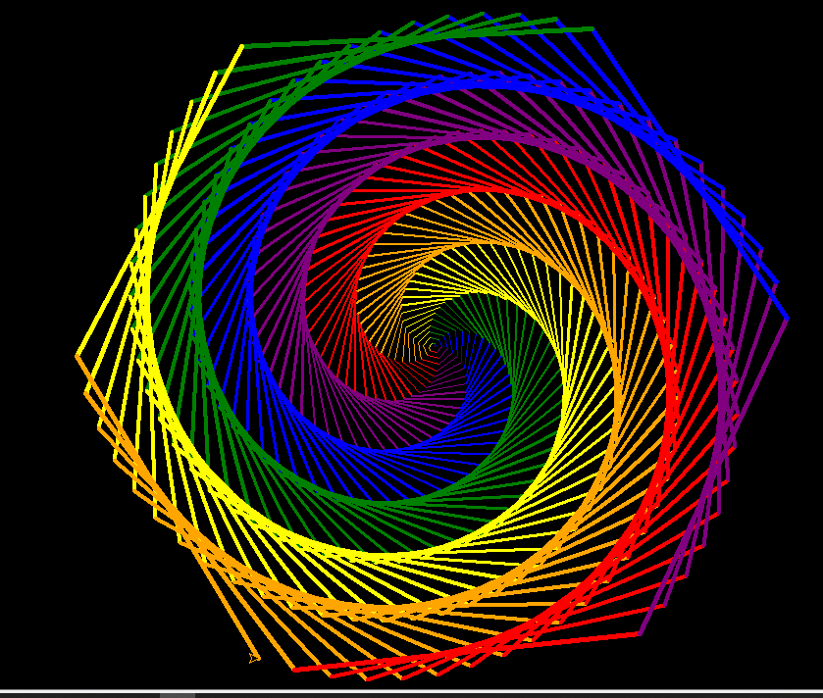
Code and learn with examples
from turtle import *
bgcolor('black')
speed('fastest')
colors = ['red', 'purple’, 'blue', 'green', 'yellow’, 'orange']
for x in range(360):
pencolor(colors[x % 6])
width(x / 100 + 1)
forward(x)
left(59)
mainloop()
Hexagonal pattern
Select a number for color
Set pen width
Make a rotation to 59 deg

Slide 13
activity

Slide 14


Assignment for level 7

Slide 16
THE END

